Slide 1
Employee Performance Calibration Process
A tool for regularly evaluating and communicating staff performance.
Date: 00/00/00 Your Name
Confidential Do Not Share

Slide 2
The Process
Use this slide deck as a template. Fill out the slides for only staff reporting to you. Share your information ahead of a meeting. Then meet for a detailed discussion about the content to get peer review, constructive criticism, and to communicate upwards the talent you have. Use this as a way to get confirmation of your professional evaluations of your staff, as well as helping to advocate for where you are focusing your staff development. Over time this will help show how staff are evolving within the organization. This tool is not meant to be used publicly, it should be privately used with staff who manage people. Regularly review quarterly with your direct peer group of managers with help from Human Resources, and your group’s leader (Director/VP/Sr. Manager/C Suite). If more than 10 people are in the meeting, break the conversation into smaller groups. The information should cascade upwards. In the interest of time, focus the conversation on High Performers, and Low Performers, then Well Placed staff as needed. (More on these categories later).
Confidential Do Not Share

Slide 3
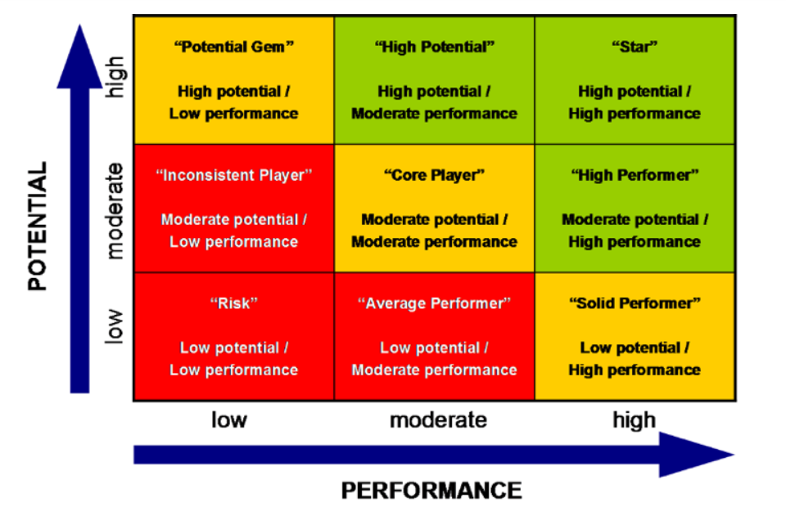
9 Box Grid Model
“A ‘nine-box grid’ or ‘3x3’ is a tool that is used to visually evaluate and communicate a group’s talent pool based on two factors, which most commonly are performance and potential. Typically on the horizontal axis is ‘performance’ measured by performance reviews. On the vertical axis is ‘potential’ referring to an individual’s potential to grow one or more levels in a managerial or professional capacity.
Confidential Do Not Share

Slide 4
Communicating Talent Health
Ideally we want our staff ‘Well Placed’ (yellow), but as a staff’s career evolves they may strengthen into ‘High Performers’ (green), or ‘Low Performers’ (red). A High Performer often isn’t being challenged enough, a Low Performer may be in the wrong role, or needs development. A Well Placed person is consistently and reliably performing for the role they are in. Since it’s not possible to equally invest in all staff at the same time, this can help us describe our focuses in managing our staff so we can get peer review, and also get support to help develop our staff.
Confidential Do Not Share

Slide 5
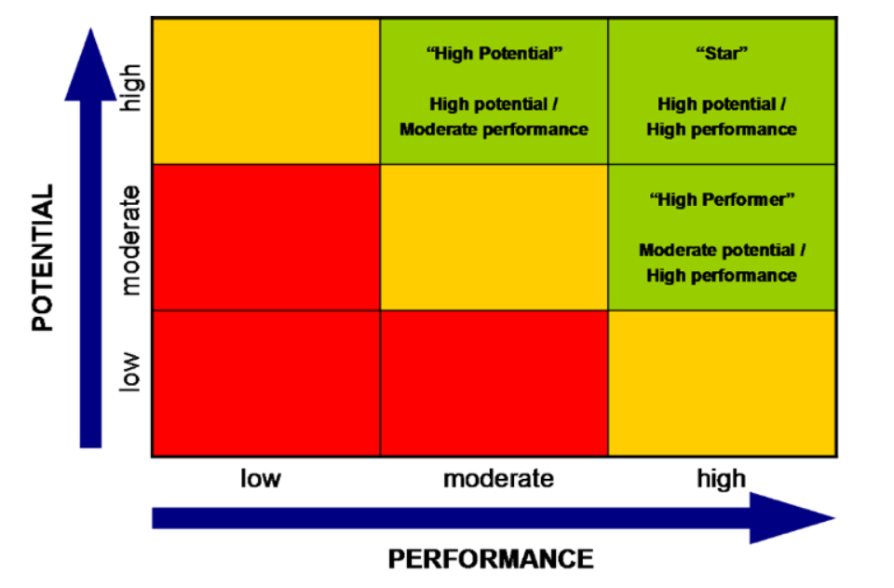
Summary High Performers
First Name, Last Name
Confidential Do Not Share

Slide 6
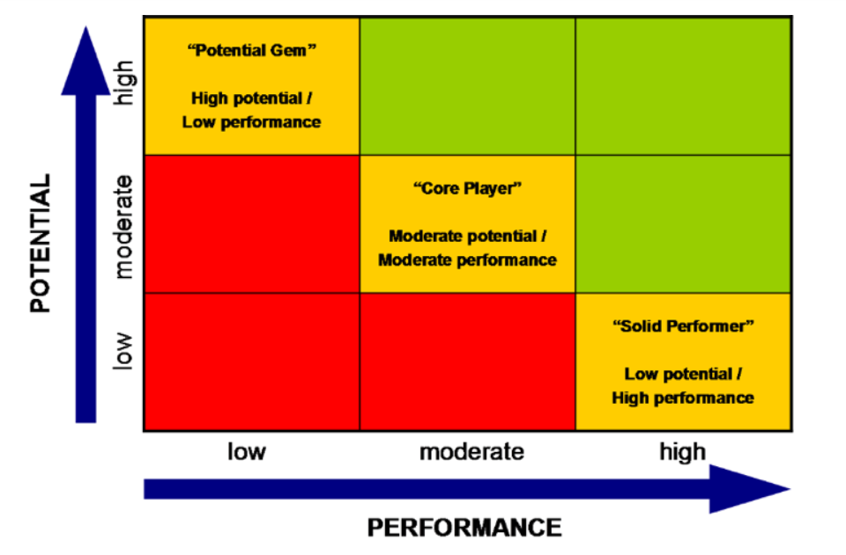
Summary Well Placed
First Name, Last Name
Confidential Do Not Share

Slide 7
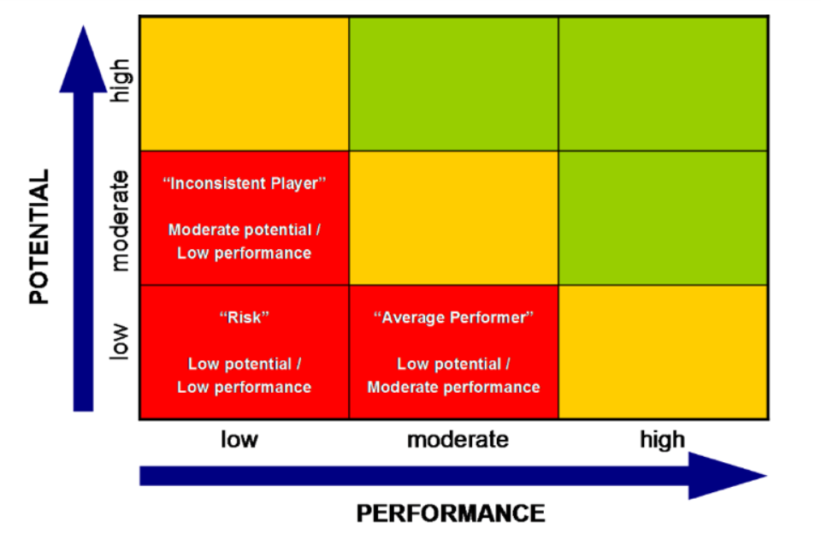
Summary Low Performers
First Name, Last Name
Confidential Do Not Share

Slide 8
First Name, Last Name
High Performer Well Placed Low Performer
Current Role: Name of Role Current Level: HR Level (Jr/Sr, or I, II, III, etc) Tenure in Current Role: Number of Years Tenure: Number of Years Manager: Name of Manager Department: Name of Department Location: City Level Location or Company Office they are based out of Employee Goals: What does this person think they want to do? Maintain, Change roles, or looking for promotion?
Manager Justification: Simple statement and observations about why the person is currently evaluated this way. Links to other supporting material is fine. Action Plan: Based on where this person is, what is the plan to help them, are they on course, or are they either low performing, or high performing, and what will be done to help them achieve the next steps. Things such as Performance Improvement Plans, Trainings, Stretch Projects, Mentorship, and Links to other supporting material is fine.
Picture of Staff
Confidential Do Not Share

